Slide 1
MPI-Programming training-2
Chun-Yuan Lin

Slide 2
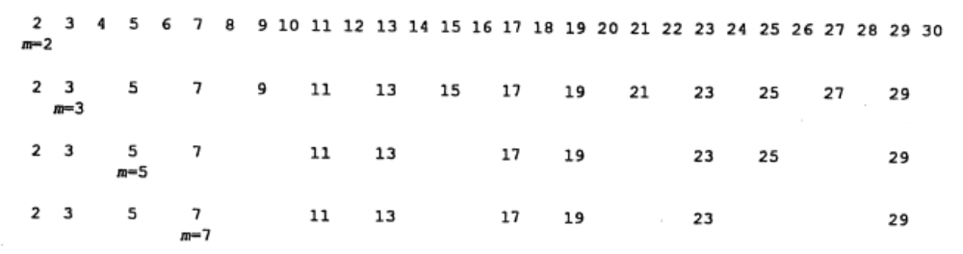
A MOTIVATING EXAMPLE
A major issue in devising a parallel algorithm for a given problem is the way in which the computational load is divided between the multiple processors.
Problem: Prime number finding
Part-I
115/11/08

Slide 3
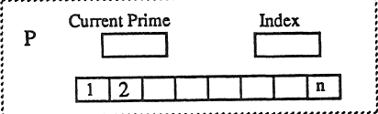
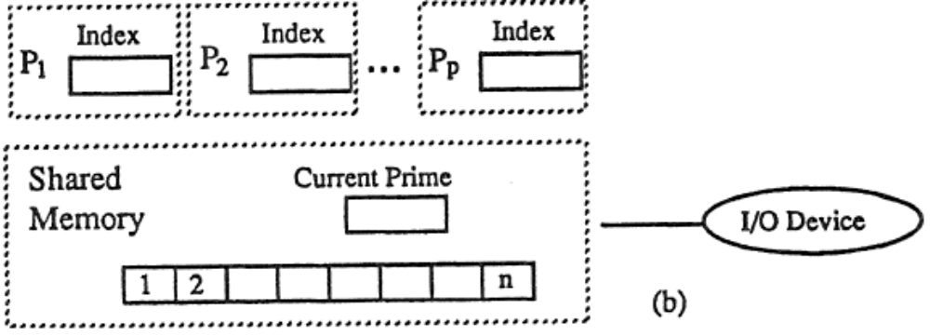
Prime number finding
Single Processor
Multiprocessors (a possible solution, share memory)
Part-I
115/11/08

Slide 4
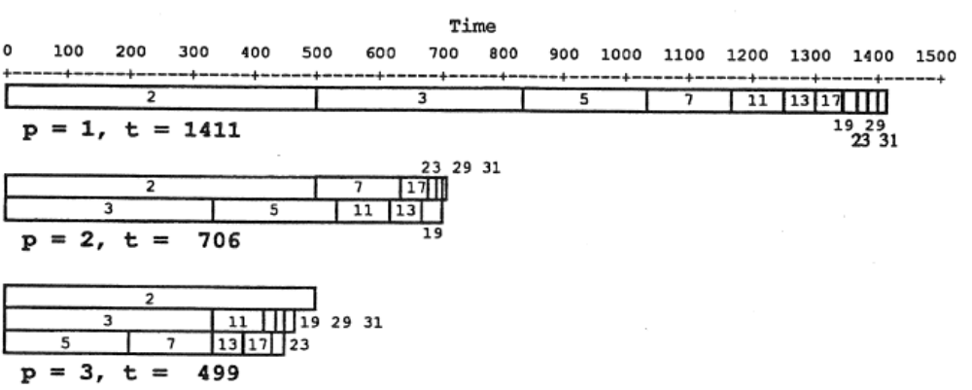
Part-I
115/11/08

Slide 5
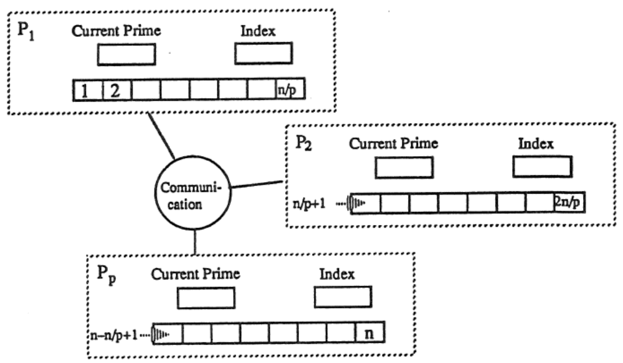
Prime number finding (cont’d.)
Multiprocessors (data parallel approach, distributed memory)
Part-I
115/11/08

Slide 6
Training
Please write a MPI program to find all prime numbers less than 10,000,000,000.
List the total number of prime numbers.
Calculate the speedup ratio for p=2, 4, 8, 16.

Slide 7
Please send the code of this training and the word file with the speedup ratio to my email. (before 4/17, 23:59).
  Please annotate your name and your student ID in email.
  The file name is “student ID”. If more than one file, the names are “student ID-1”, “student ID-2”, etc.
  Please compress the files to a .zip or .rar file. The file name is “student ID-train2”.
For example, a student has ID “A0000001” and two files. The file names are A0000001-1.c and A0000001-2.c and the compressed file name is A0000001-train2.zip.
The file will be rejected without following the rules.

